Slide 1
HR DATA VISUALIZATION
A.Veerendra Nath|Sri Tandra Varsha

Slide 2
Problem Statement & Objectives
Problem: Predict whether a candidate is actively looking for a new job.
Objective:Use data visualization to uncover patterns and build predictive models.

Slide 3
Dataset Overview & Preparation
Contains employment and education-related data of enrollees.
Includes 15 features such as city, education level, experience, company size, and training hours.
Covers relevant experience, university enrollment, and job change patterns.
Features a city development index to assess economic conditions.
Useful for predictive modeling and workforce analytics.
Data Preprocessing:Handled missing values, feature engineering, categorical encoding.

Slide 4
Dealing with missing values
When handling missing values, the approach is often subjective. Personally, I prefer to retain categorical data wherever possible, as the absence of certain attributes—such as company size or company type—might hold valuable insights.
Similarly, I will keep the missing values in the gender column, as 30% of these instances have a target value of 1 (indicating they are looking for a job change). This suggests that missing gender data could be a significant factor, even if its exact influence is unclear at this stage.
Target variable:
0 – Not looking for a job change
1 – Looking for a job change

Slide 5

Exploratory Data Analysis & Visualization
Data Visualization This will be an EXPLORATORY visualization.I will also make use of GridSpec as I want to practice this technique.Let's see if we can understand why people might look for a new job...
The image appears to be a color bar, likely representing a gradient or categorical color mapping. Here’s what it suggests:
Four distinct color segments: The bar consists of four distinct colors, ranging from dark green to dark blue, gray, and white. Possible Data Representation: This could represent categories, intensity levels, or some form of grouping in a dataset. Usage in Data Visualization: Such color bars are often used in heatmaps, categorical encodings, or continuous gradient visualizations in data science, particularly in tools like Matplotlib or Seaborn.

Slide 6
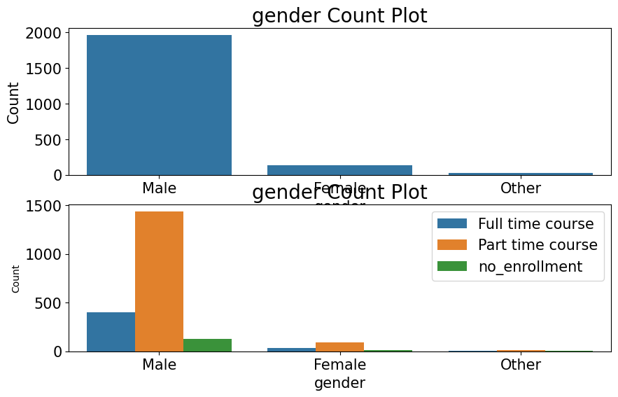
The graph consists of two subplots analyzing gender distribution and course enrollment status.
Top Plot (Gender Count Plot):
Males make up the majority of the dataset, with a significantly higher count than Females and Others. The number of Females and Others is much smaller in comparison. Bottom Plot
(Gender vs. Course Enrollment):
Males dominate all course enrollment categories, with a high number enrolled in part-time courses. A smaller proportion of Males opt for full-time courses or no enrollment. Female and Other genders have very low representation in all course categories.

Slide 7
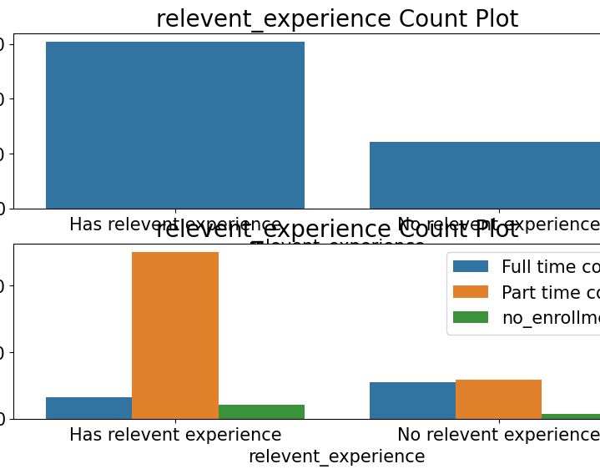
The graph contains two subplots analyzing the distribution of relevant experience and its relation to course enrollment.
Top Plot (Relevant Experience Count Plot):
The majority of candidates have relevant experience, with their count significantly higher than those without relevant experience. Bottom Plot
(Relevant Experience vs. Course Enrollment):
Among those with relevant experience, most are enrolled in part-time courses, while fewer opt for full-time courses or no enrollment. Among those without relevant experience, the distribution across full-time, part-time, and no enrollment is more balanced, though the overall count is lower.

Slide 8
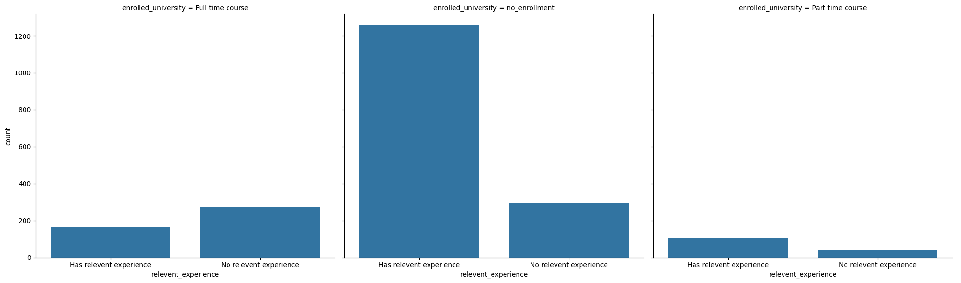
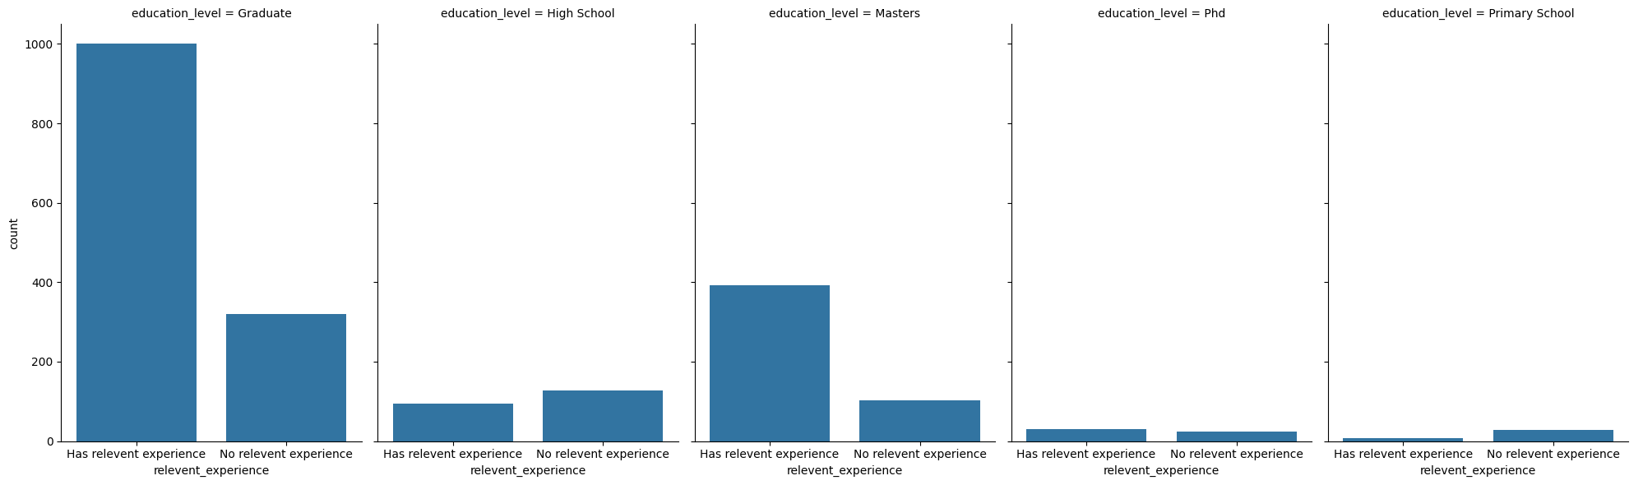
Visualizing Categorical Data with Seaborn's Catplot
We can see that 'Full time course' + 'No relevent experience' value has strong correlationship with target.
It shows that 'Graduate' with 'No relevent experience' has very strong correlationship with target, also Master too.

Slide 9
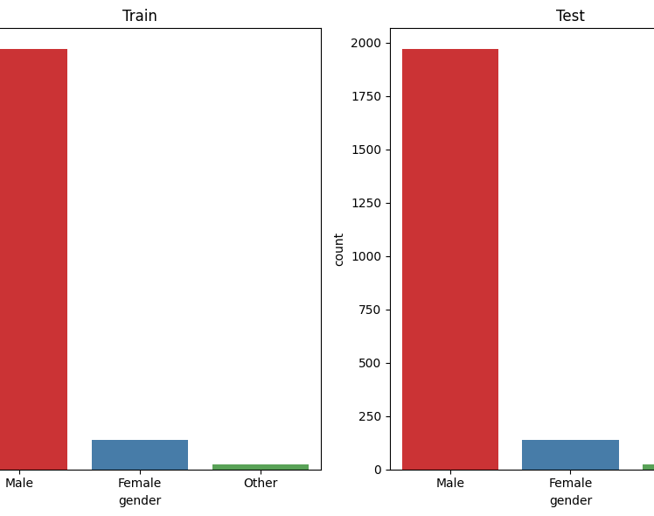
Gender Distribution
The graph shows the gender distribution in both Train and Test datasets. Males form the majority in both datasets, significantly outnumbering other genders. Females have a much lower count compared to males but are still present in noticeable numbers. The "Other" gender category has the lowest count in both datasets. The distribution pattern in the Train and Test datasets appears consistent, ensuring a balanced gender proportion across them.

Slide 10
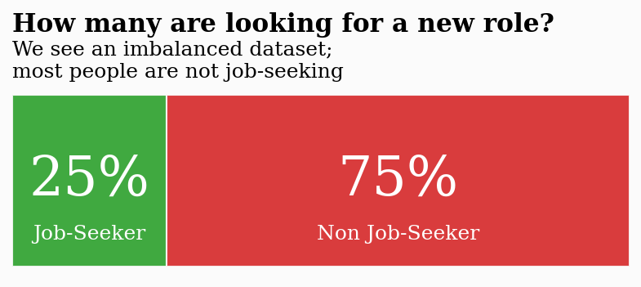
Our dataset is imbalanced, meaning there are significantly more non-job-seekers than job-seekers.
While this imbalance is something we’ll address later, for now, let’s focus on further exploring the data.
Comparing Train & Test Sets A key step in data analysis is understanding how the training and test sets compare. One useful way to visualize this is by using GridSpec, which allows for flexible and customizable multi-plot layouts.
Mastering GridSpec is a valuable skill, as it helps present a large amount of information efficiently within a compact space.
Now, let’s compare the Train & Test sets visually...

Slide 11
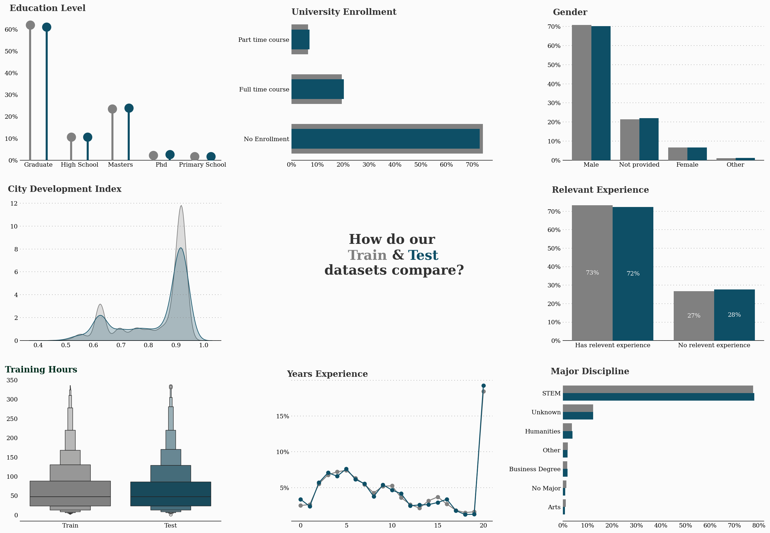
let’s compare the Train & Test

Slide 12
The Train & Tests sets are similar - that's good news If the training set has wildy different characteristics to our test set then we really are in for a difficult time.
We'd need to ask if the training population can really help us predict the target.
In this case though, we're fine.
Now let's focus on the Training set and explore the data... You'll note that I often incoroprate text in to my visuals. I'll often an annotations to the plots themselves, for example at the 'mean', or at peaks in the data etc.
In this case, I've included an explanation of what we're seeing and what it might mean. This helps your audience to understand your data, but it also helps them to get thinking in a way that is in line with the story you are trying to craft.

Slide 13
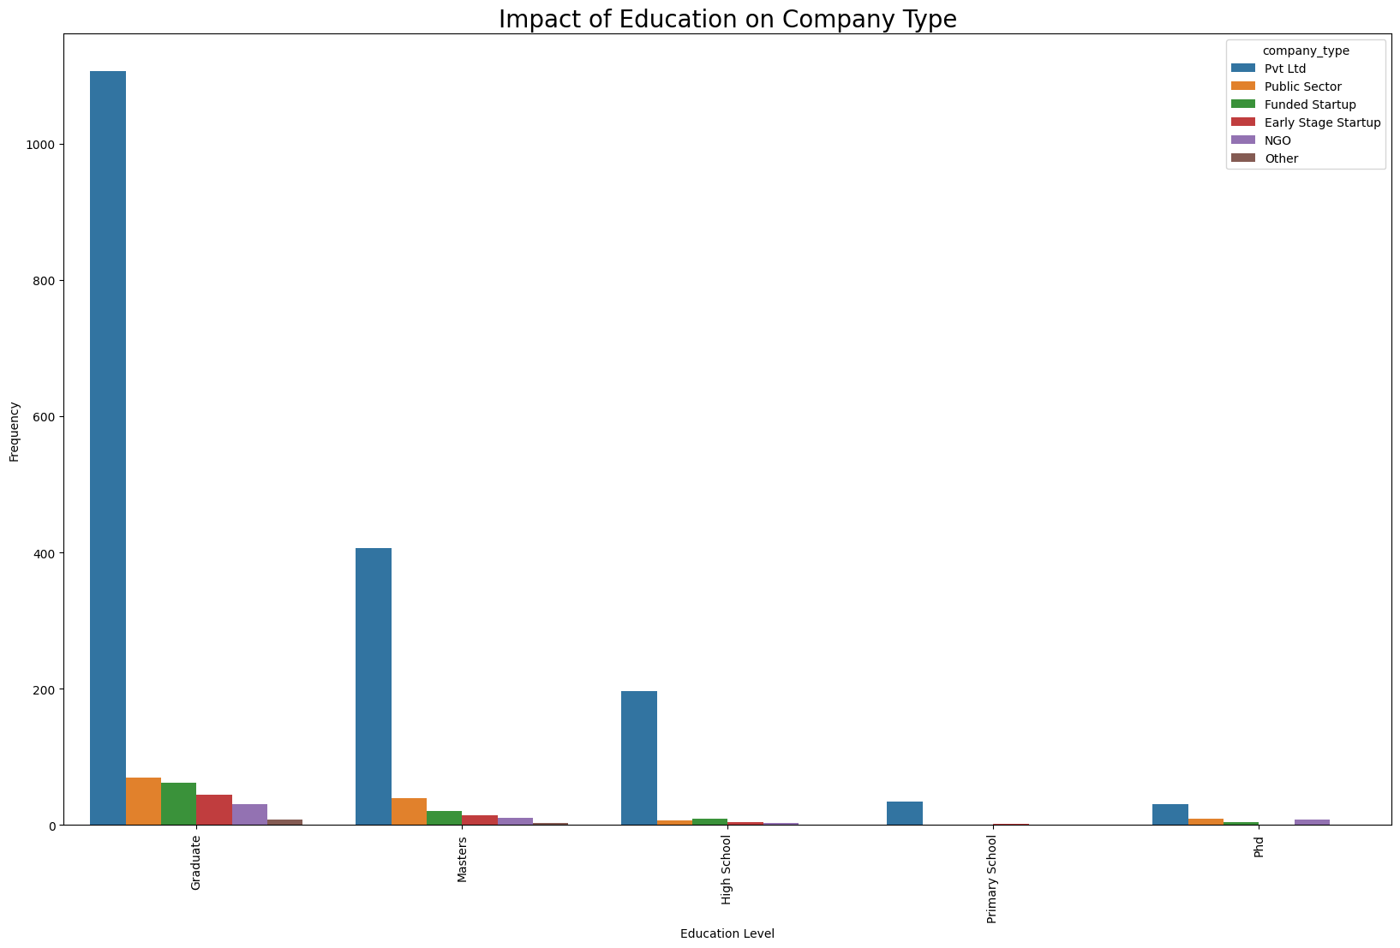
Impact of Education on Company Type
X-axis: Represents different levels of education (e.g., Graduate, Masters, High School, Primary School, PhD).
Y-axis: Represents the frequency (or count) of people in each education level working in different types of companies. Bars: Each color represents a different company type (e.g., Pvt Ltd, Public Sector, Funded Startup, etc.).
Graduates have the highest employment opportunities in all company types. Pvt Ltd companies hire the most people across all education levels. Higher education (like Masters or PhD) is less common in this dataset but still contributes to employment.

Slide 14
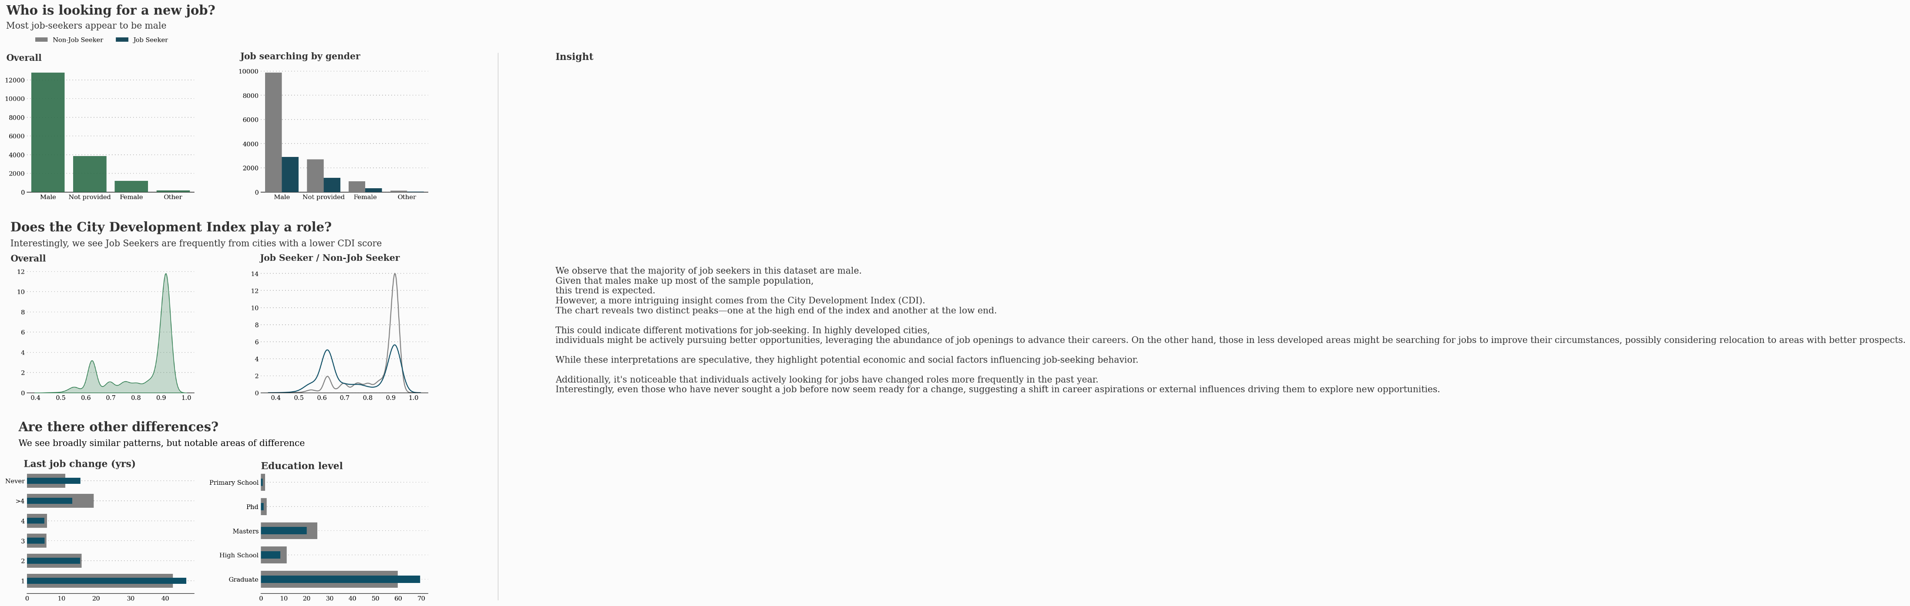
Client Perspective: Key Questions & Considerations

Slide 15
Insight:
Findings:
While the dataset shows that most job-seekers are male
—reflecting the overall sample composition
—an intriguing pattern emerges in the City Development Index (CDI) chart. Job-seekers appear to cluster at both high and low CDI scores. In high CDI areas, abundant opportunities might encourage individuals to pursue better roles, whereas in low CDI areas, candidates may be motivated to seek new jobs to improve their circumstances. Although speculative, this observation raises interesting questions about regional job-seeking behavior. Additionally, job-seekers seem to have changed jobs more frequently over the past year compared to non-job seekers, and even those who have never actively searched for a job appear ready for a new challenge.
The dataset shows that the majority of job-seekers
are male, which is consistent with the overall population distribution.
The City Development Index (CDI) for job-seekers exhibits two distinct peaks—one at high CDI scores and one at low CDI scores—Indicating a bimodal distribution.
Job-seekers have a higher frequency of job changes within the past year compared to non-job seekers.
Individuals who have never looked for a job also seem to be ready for a new challenge, hinting at underlying factors driving job transition behavior.

Slide 16
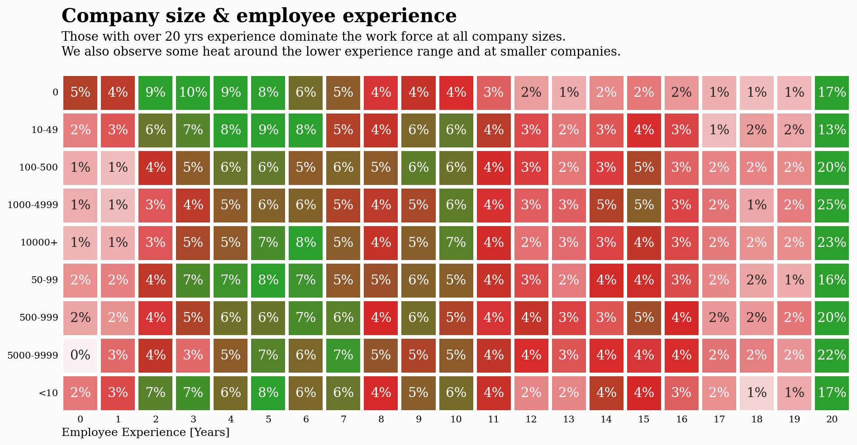
Why do smaller companies attract both very experienced and entry-level employees, and how should we adjust our recruitment and retention strategies accordingly?

Slide 17
Findings:
Senior Professionals are present in both small and large companies, indicating a broad distribution of highly experienced talent.
Entry-Level Hires cluster more in smaller firms, possibly reflecting greater openness to junior staff or a more flexible hiring approach.
Mid-Level Experience appears evenly distributed, highlighting a diverse range of experience levels across organizations of various sizes.
Insight: Employees with over 20 years of experience form a significant portion of the workforce across all company sizes. Meanwhile, smaller organizations seem to attract a higher proportion of entry-level talent, suggesting different hiring and retention strategies based on company scale.

Slide 18
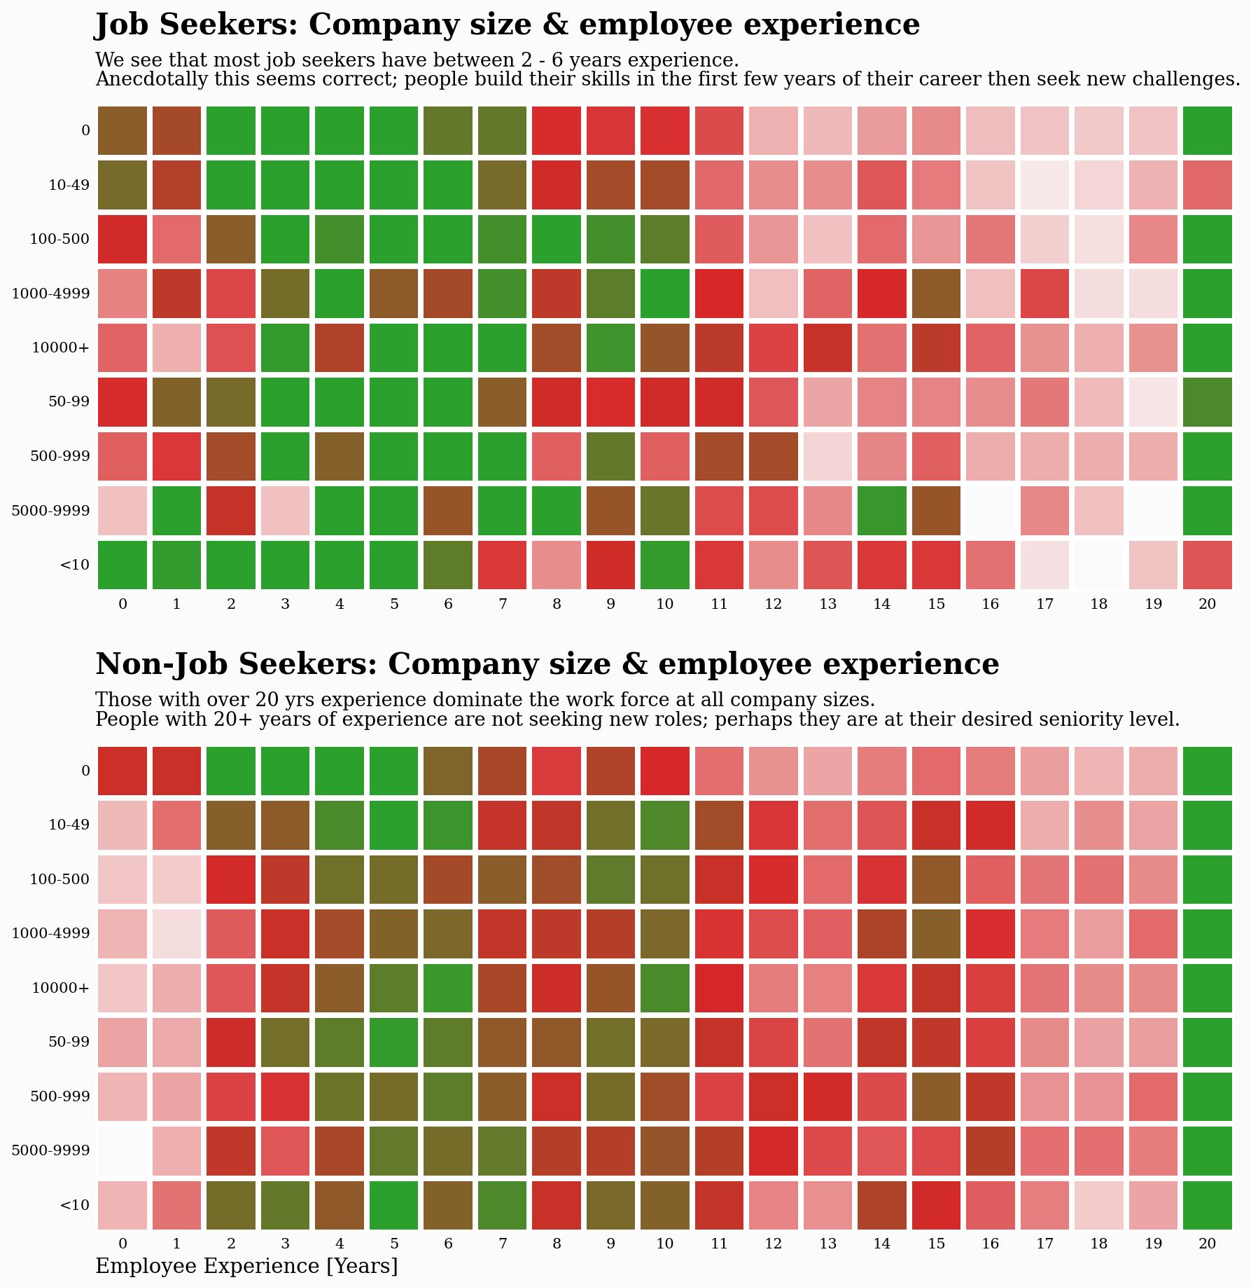
Why do most job-seekers have between 2–6 years of experience, while those with 20+ years tend to remain in their current roles across all company sizes?

Slide 19
Insight: Early-career professionals (2–6 years of experience) often seek growth or new challenges, leading to higher job-seeking activity. Meanwhile, long-tenured employees (20+ years) appear more settled and are less likely to change roles.
Finding:
Job-Seekers: Concentrated in the 2–6 year experience range, particularly at smaller to mid-sized companies.
Non-Job Seekers: Dominated by employees with over 20 years of experience, suggesting career stability or fewer incentives to switch roles.

Slide 20
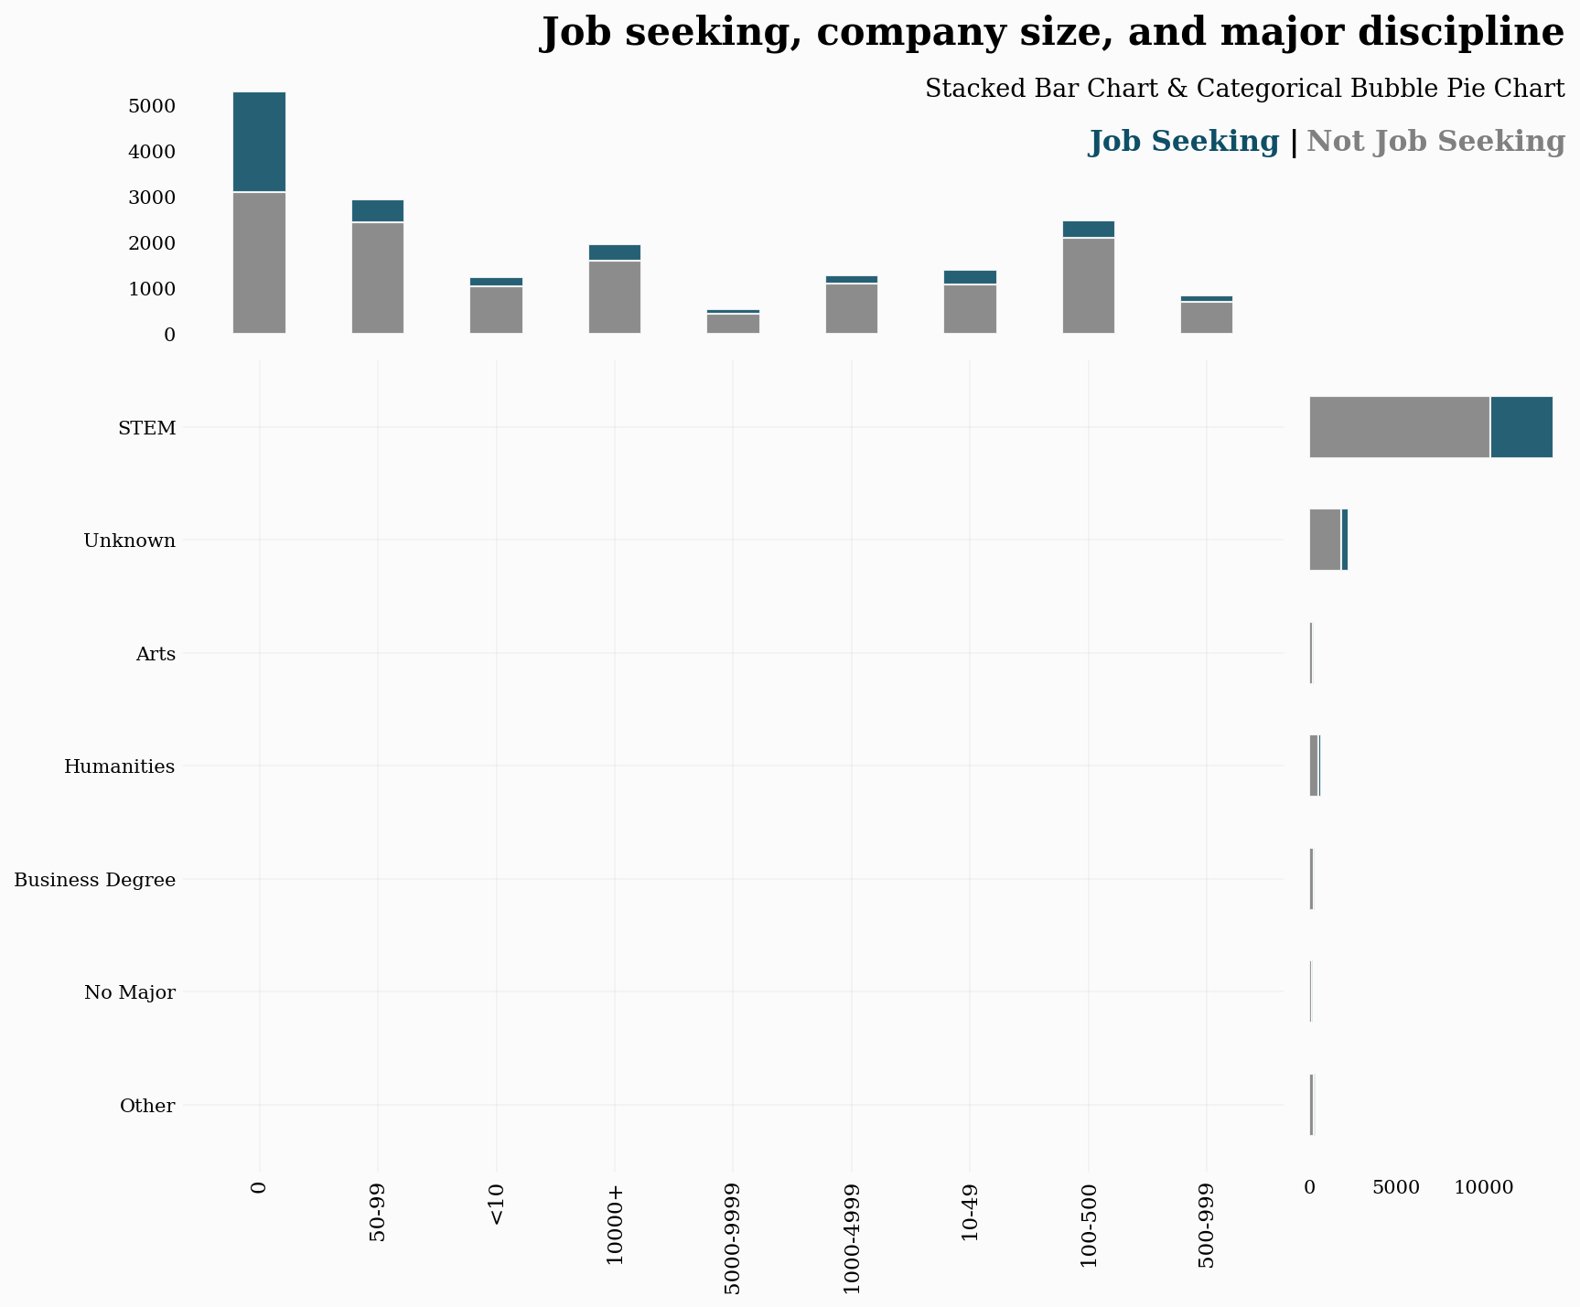
How does a candidate's major discipline, particularly STEM, influence job-seeking behavior across different company sizes?

Slide 21
Insight STEM graduates form a significant portion of job seekers in both small and large companies, suggesting higher mobility or demand for specialized skills. Non-STEM disciplines and those with unknown majors show varied but generally lower job-seeking rates.
Finding
STEM Dominance: STEM majors consistently appear in greater numbers
among job seekers across multiple company sizes.
Unknown Majors: A notable group with unreported or unclear educational backgrounds also engages in job seeking.
Smaller vs. Larger Companies: Smaller companies attract a sizable share of
STEM job seekers, indicating an openness to specialized talent at various organizational scales.

Slide 22
The main purpose of the notebook is of course visualization, but I wanted to finish the process with the process of selecting a predictive model
I won't spend much time fine-tuning these models, but as long as we get a fairly decent result, above the Null Accuracy Score, I will be content. I will also visualize the results.

Slide 23
Modelling
To identify the most effective classification approach, we tested multiple algorithms, including Linear SVM (with GridSearchCV), SVC (sigmoid kernel), Decision Trees, Random Forest (untuned and tuned), Logistic Regression, and K-Nearest Neighbors.
We used StandardScaler to ensure feature values were on a consistent scale and applied hyperparameter tuning (e.g., GridSearchCV) to optimize performance.
Evaluation Metrics & Results Each model’s performance was evaluated using accuracy, recall, precision, and ROC AUC, providing a comprehensive view of predictive quality. Confusion matrices were also generated to visualize true positives, false positives, and other classification outcomes. By comparing these metrics across models, we gained insights into each algorithm’s strengths and weaknesses, ultimately guiding us toward the most effective solution for our dataset.

Slide 24
SMOTE
SMOTE is a technique that helps deal with imbalanced data sets.
A great introductory article can be found here:
https://www.geeksforgeeks.org/ml-handling-imbalanced-data-with-smote-and-near-miss-algorithm-in-python/
The common error I see people making is to use SMOTE and THEN split their data in to train & test sets. This is a big mistake as you will get some serious data leakage and end up predicting synthetic results that you have just created - it does not make sense.
Instead, split your data first, and THEN use SMOTE on the training data only.
Let's see if it helps here...

Slide 25
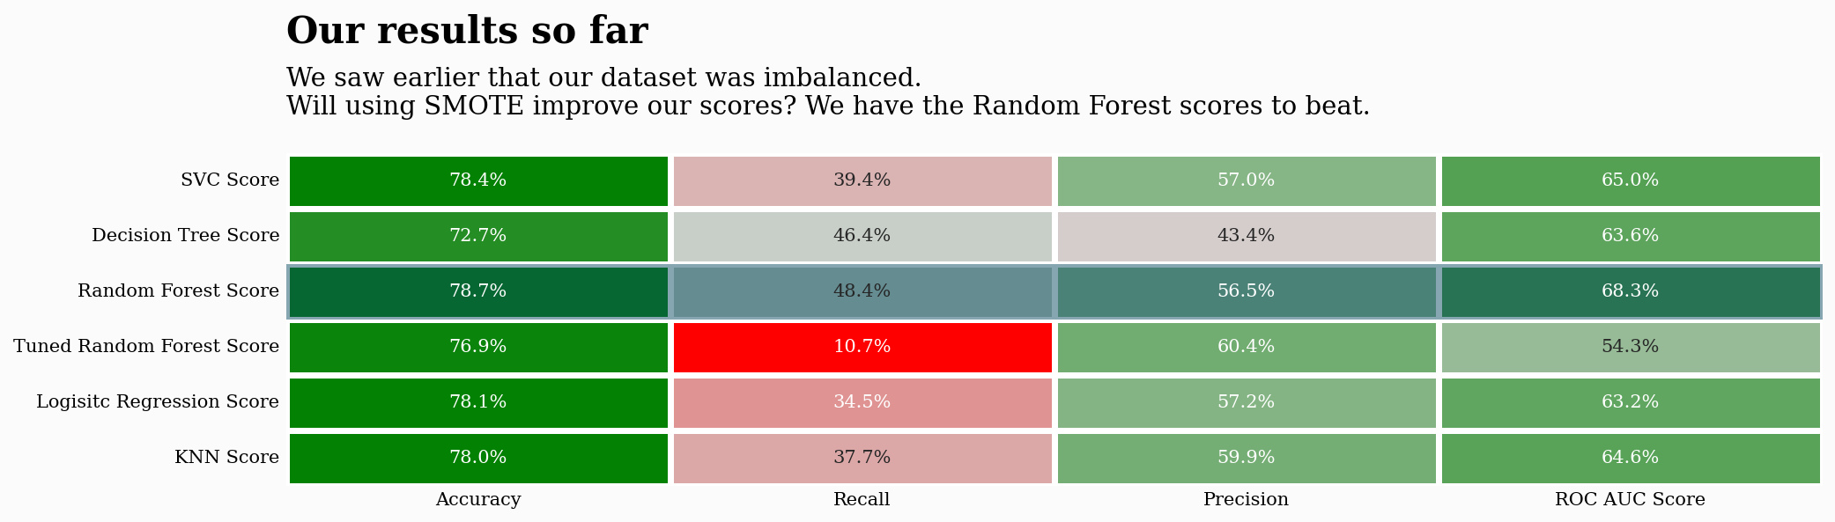

Slide 26
On the training set at least, we are doing very well.
I used f1 score as the metric as this is a weighted blend of accuracy & recall.
Let's try the test data...

Slide 27
Based on the problem statement: "Predict employees who are job seeking", our model of choice
will be Logistic Regression using SMOTE. This model has the highest recall score, a high accuracy
overall, and is quick to run & re-train if required.
By using SMOTE, which is Synthetic Minority Oversampling Technique, we have dramatically
improved our results.
Our final Logistic Regression model performs well on all metrics - particularly recall. but without
sacrificing performance in other metrics.
With the highest recall & ROC AUC scores, this model would certainly be valuable for this HR
department.It has the added advantage of being very quick to train, too.
The only downside with the model is that it often predicts that a person is looking for a new role
even if they are not.
However, on balance, I think this model is still worthy of selection.

Slide 28
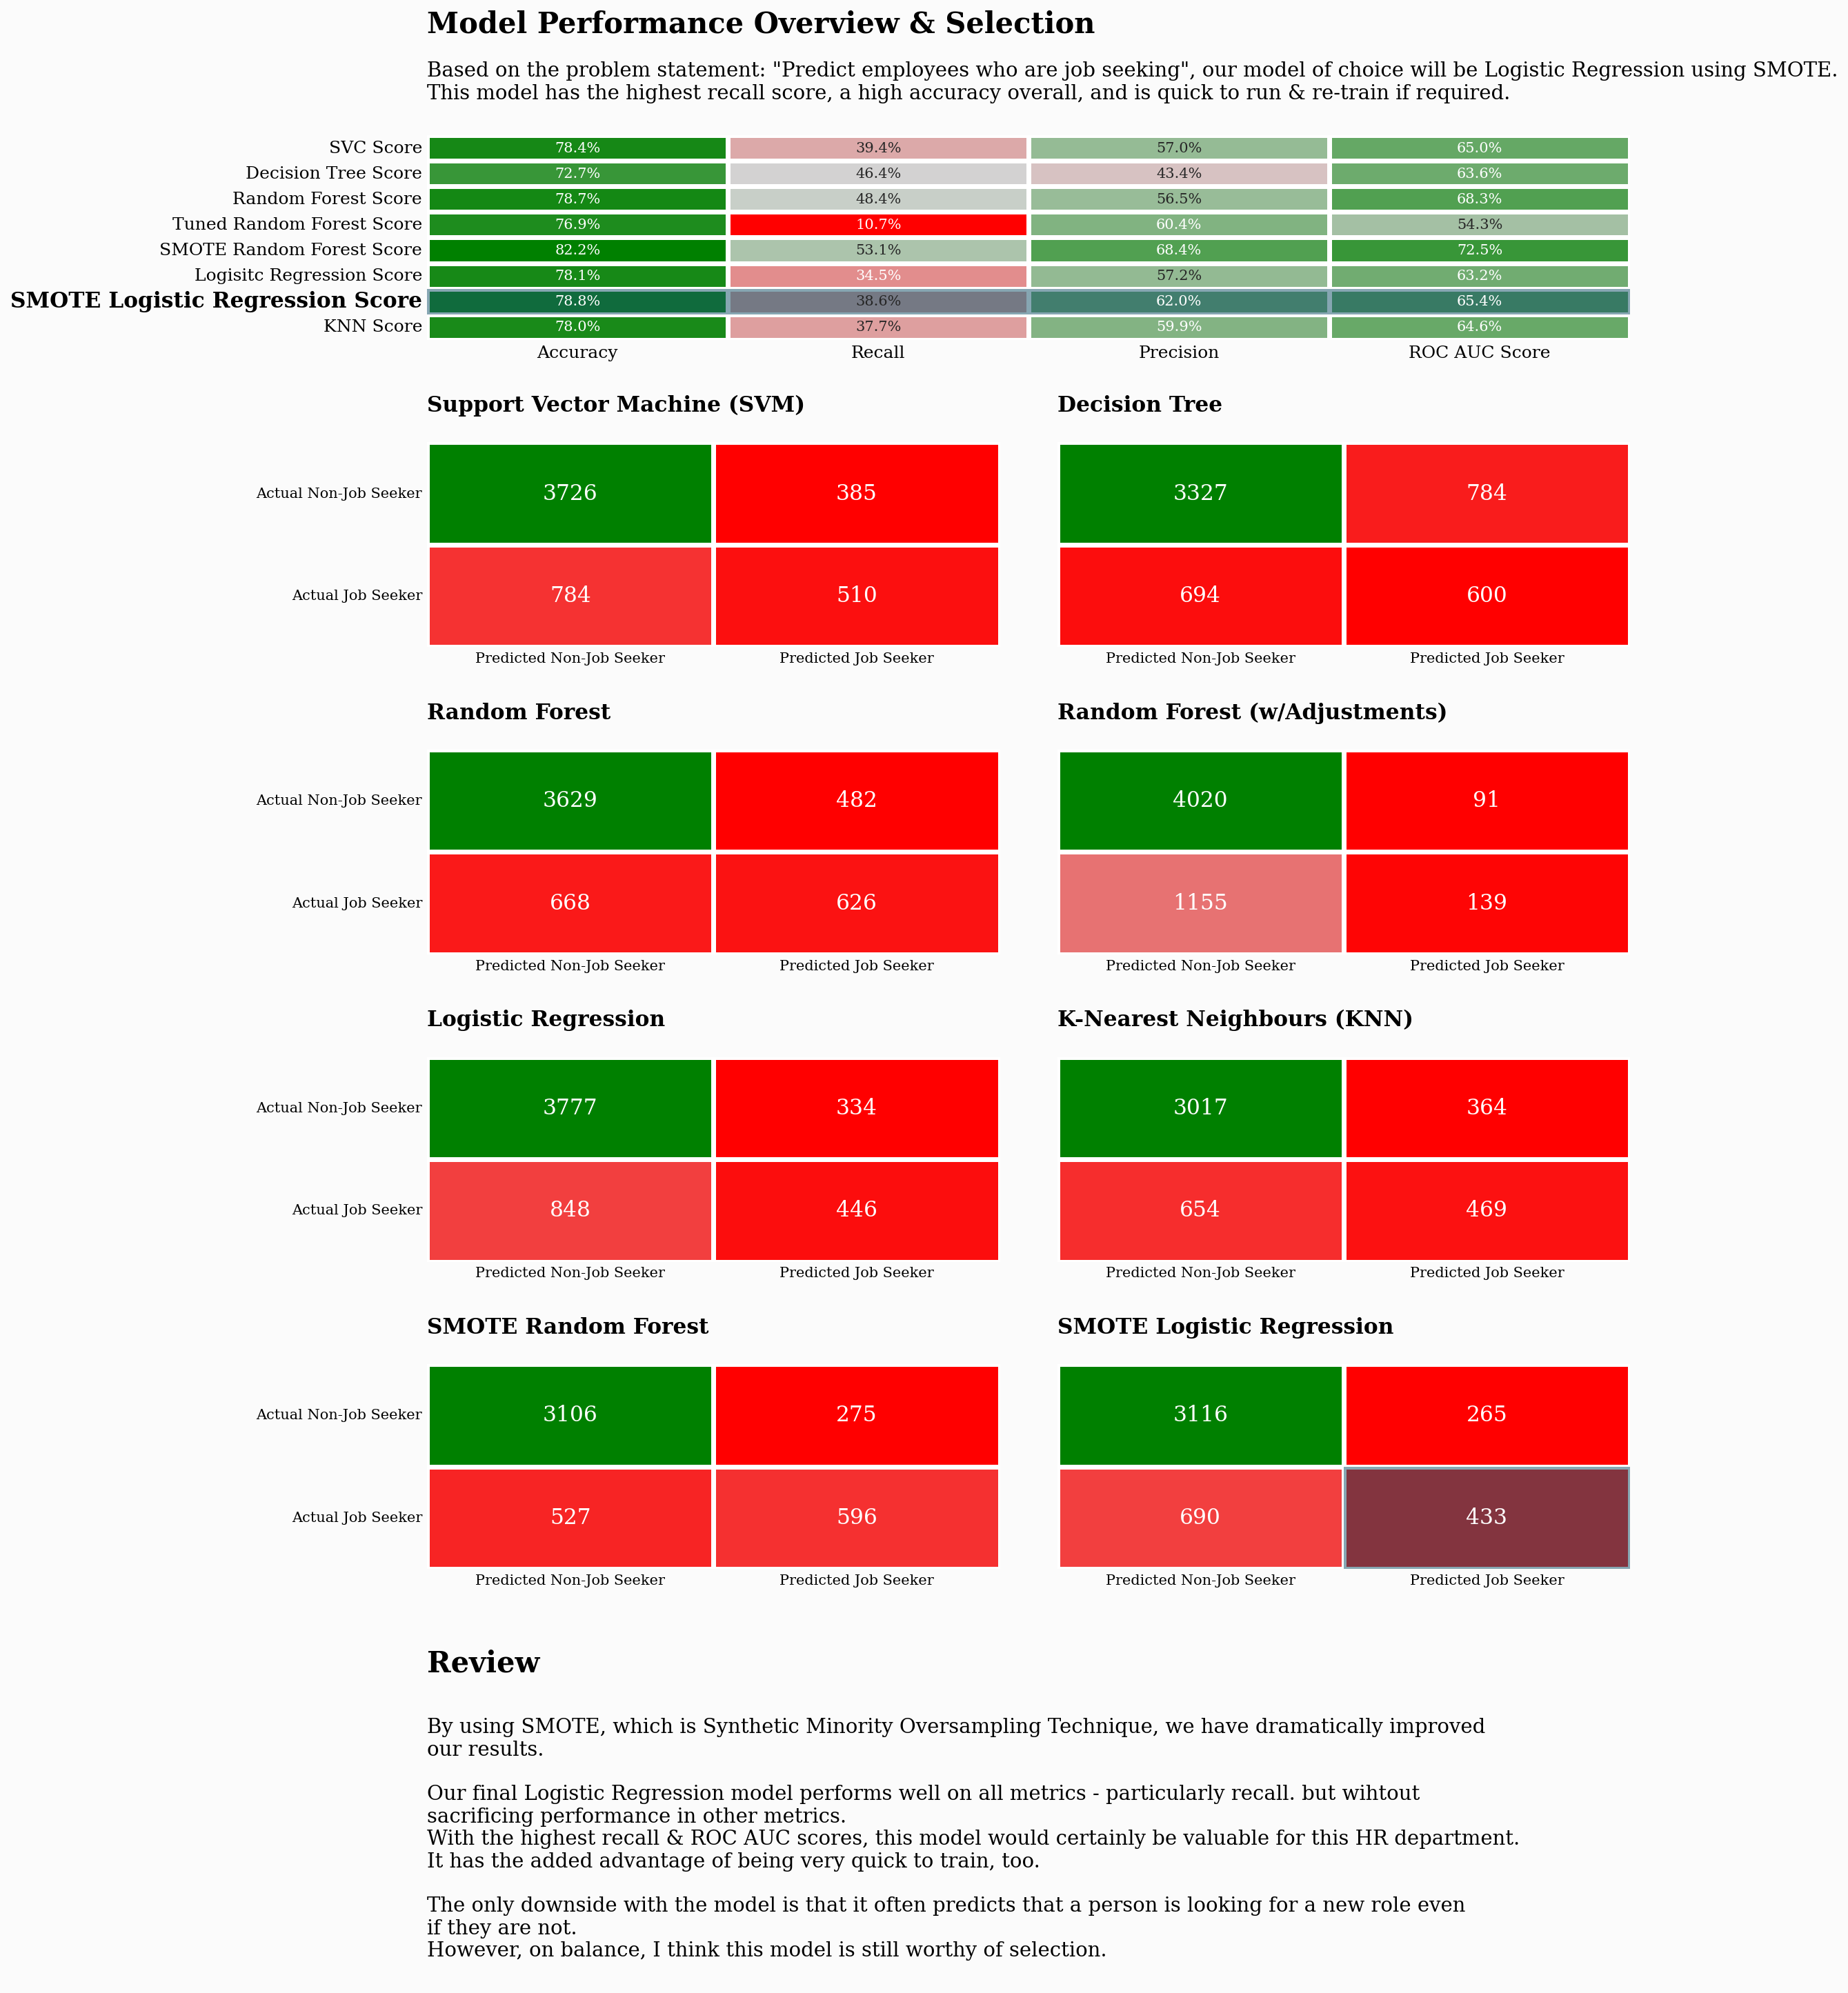

Slide 30
Borderline SMOTE
Something else... Borderline SMOTE There are many oversampling techniques that one could employ.
A variation of the technique used above is Borderline SMOTE.
Borderline SMOTE involves selecting those instances of the minority class that are misclassified.
We can then oversample just those difficult instances, providing more resolution only where it may be required
A great article cab be found here:
https://machinelearningmastery.com/smote-oversampling-for-imbalanced-classification/

Slide 31
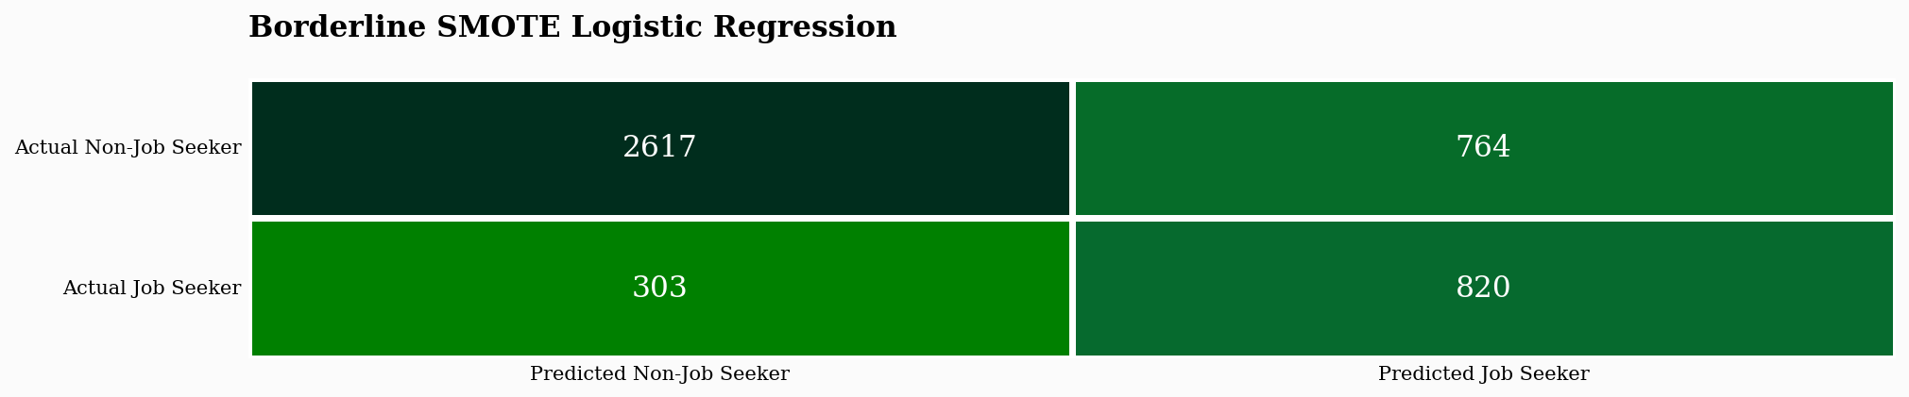
This graph is a confusion matrix for the Borderline SMOTE Logistic Regression model, showing its classification performance.
2617 Non-Job Seekers were correctly predicted (True Negatives).
764 Non-Job Seekers were misclassified as Job Seekers (False Positives).
303 Job Seekers were misclassified as Non-Job Seekers (False Negatives).
820 Job Seekers were correctly predicted (True Positives).
It visually represents how well the model distinguishes between job seekers and non-job seekers.
We see above, that by using Borderline SMOTE we have managed to improve recall, capturing 964 job seekers as opposed to 960 with regular SMOTE.

Slide 32
Conclusion:
In summary, we explored and visualized our data using engaging methods, addressing null values and performing feature engineering to obtain a more complete view.
We applied several machine learning algorithms
—including SVM, Decision Trees, Random Forests, Logistic Regression, and KNN—to predict job-seeker status. To improve model performance, we addressed data imbalance using SMOTE and retrained our Logistic Regression and Random Forest models, with Logistic Regression emerging as the top performer.
Although minimal model tuning was done, our results are promising and can be further enhanced through hyperparameter tuning and threshold manipulation. Ultimately, we presented our findings in a manner that is clear and accessible to business stakeholders, outlining actionable next steps for future improvements.

